Slide 1
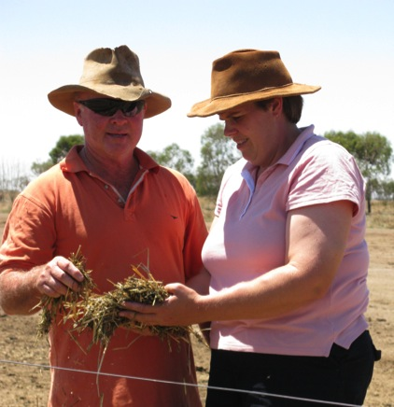
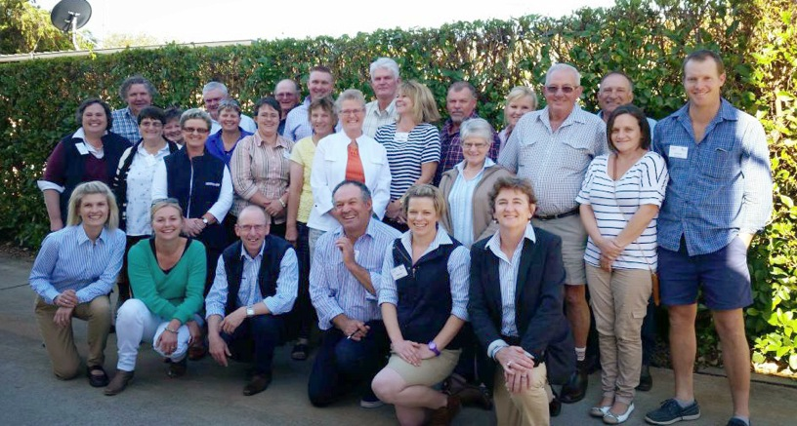
Sustainable
Farm Families™
The most important aspect of a healthy Australian farm?
A healthy farming family.
www.farmerhealth.org.au/sustainable-farm-families/sff-programs

Slide 2
Background
Research suggests that the general health of rural people is, by urban standards, very poor” AIHW 2011
“Rural populations have above average rates of premature mortality and death through heart disease, cancer, and suicide” AIHW 2011
Notes:
Why do rural populations have higher rates? Unsafe farming practices, delayed treatment, less access to healthy foods, perception that farmers are stoic and won’t ask for help, etc.

Slide 3
Why focus on the health of farmers?
Little is known about the health status of farmers
Farming communities are different
Proven industry with elevated risks
Difficult to access, educate and retain Australia relies on this important industry

Slide 4
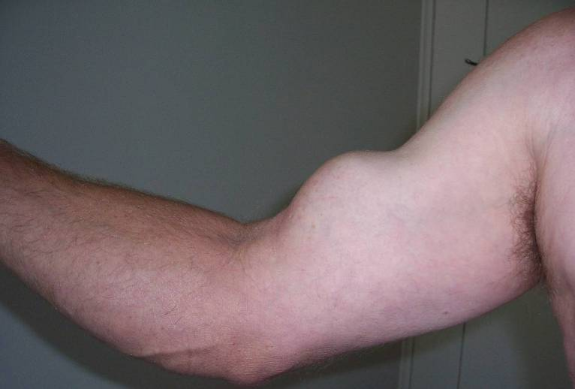
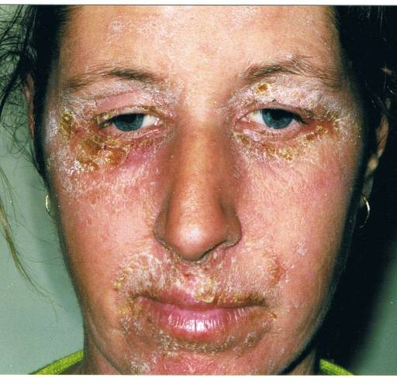
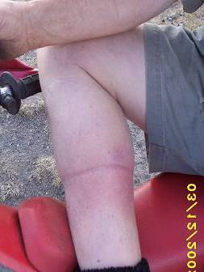
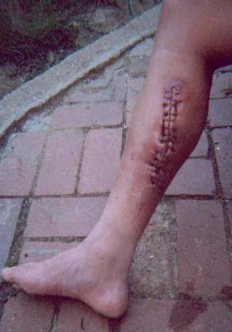
Sustainable Farm Families™ ©2015
Notes:
Here are some photos of why we need to speak about farming families. What would be proper compensation for these injuries and how long would these farmers need to spend off farm for recovery and treatment?
Ruptured bicep – lifting too heavy weights.
Allergic reaction to drench – safe use of farm chemicals
Site of self injection with Johnes Vaccine (1 week, 6 weeks (surgery), 6 months (healing)) – knowledge of first aid and reasons to seek immediate treatment.

Slide 5
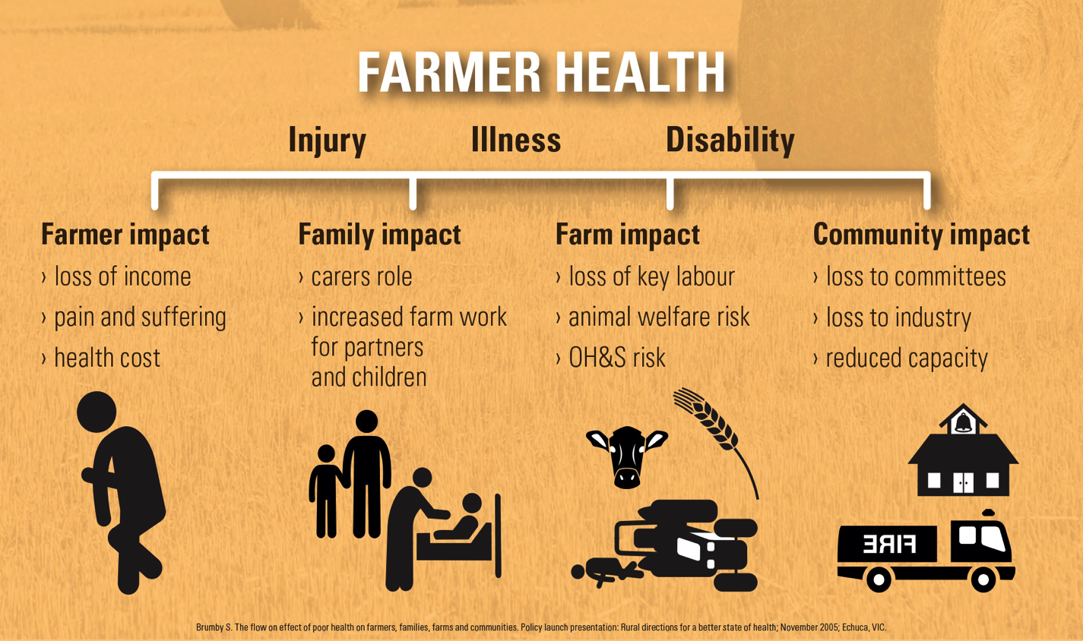
Notes:
The impact that the health of farmers can have on family and community.

Slide 6
So how can we go about changing this? (Squamous cell carcinoma)
Notes:
Photo of shearers back.

Slide 7
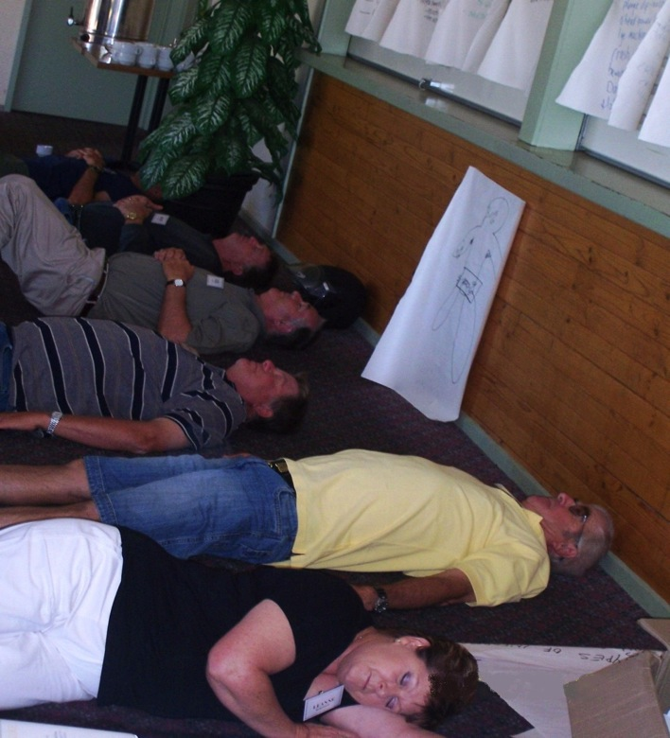
To farming families who practice this? (Meditation)
Notes:
Meditation, which is taught through SFF.

Slide 8
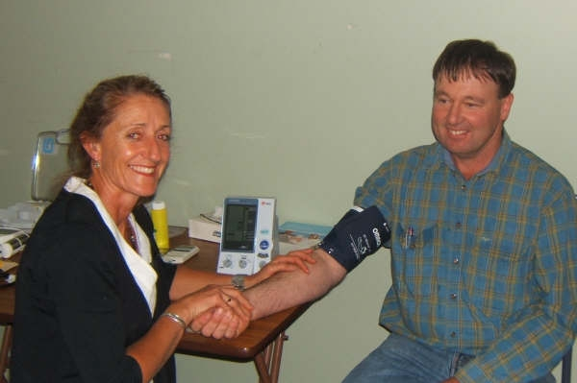
Or monitor this? (Blood pressure)
Notes:
Health checks are a popular part of the program.

Slide 9
Sustainable Farm Families approach
Better health
Better understanding
Better business
Notes:
The triple bottom line.

Slide 10
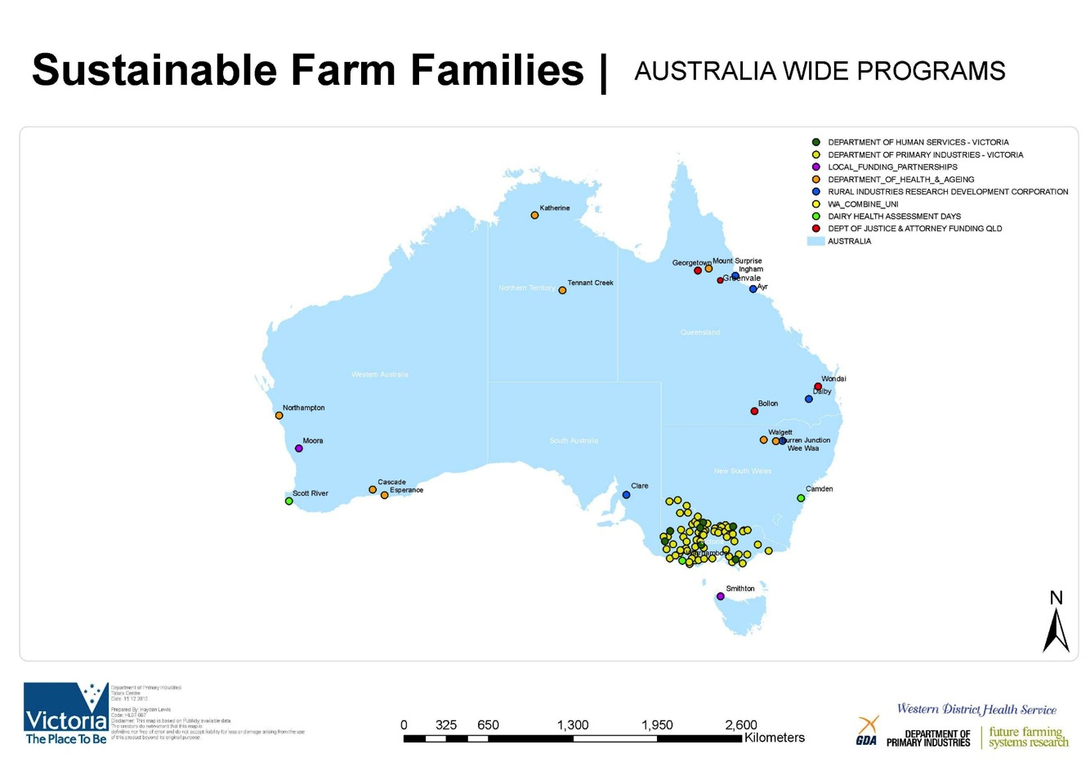
Spreading the SFF approach
Notes:
Some of the places around Australia where SFF has been.

Slide 11
Outcomes of SFF program
Body mass Index
Weight
Waist measurement
Lowered cholesterol
Lowered blood pressure
Increased feeling of health and wellbeing
Increased use of OH& S items

Slide 12
What you say about SFF
‘It is very informative – I know so much more about my own health and my partners.’
‘Definitely very worthwhile and informative.’
‘Run at an appropriate level that I could understand.’
‘The increased knowledge and understanding, has given me the ability to lead a healthier and happier lifestyle.’

Slide 13
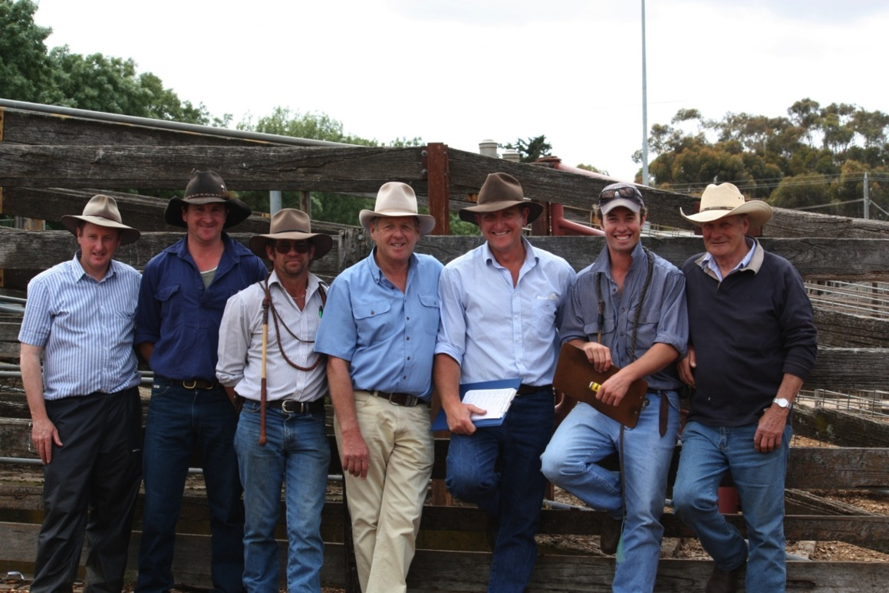
A participants perspective
Sustainable Farm Families™ ©2015
Notes:
Still a little confused? – Here’s what some of our programs have looked like.

Slide 14
Toowoomba 2014/15
Sustainable Farm Families™ ©2015

Slide 15
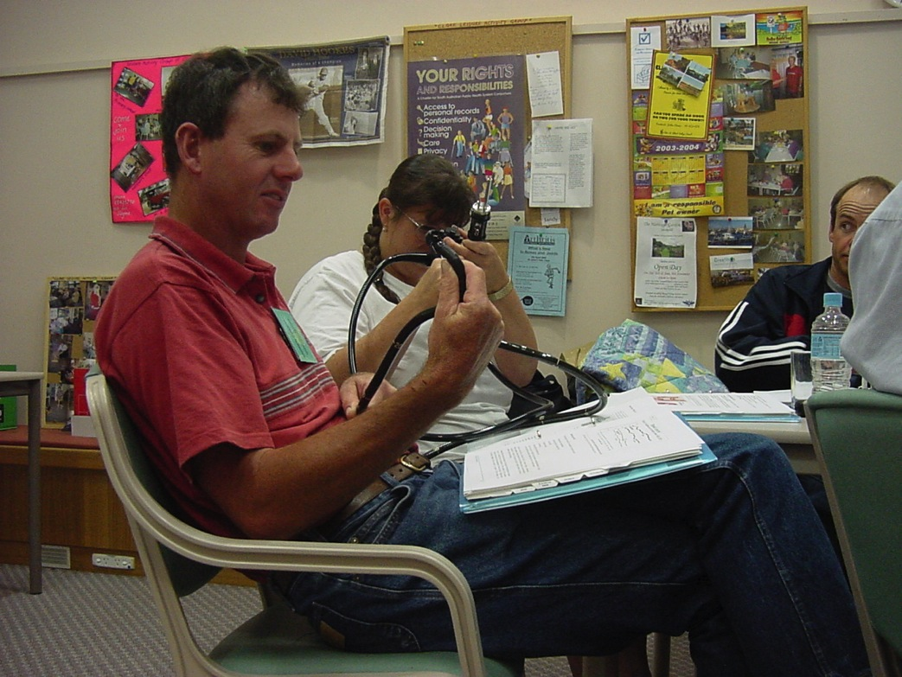
Sustainable Farm Families™ ©2015
Notes:
During the session. A participant learning about colonoscopies.

Slide 16
Sustainable Farm Families™ ©2015
Notes:
Participants on the supermarket tour learning about label reading.

Slide 17
Sustainable
Farm Families™
The most important aspect of a healthy Australian farm?
A healthy farming family.
List programs taking place in your area

